Slide 1
COMPUTER PRESENTATION
TOPIC : EXCEL

Slide 2
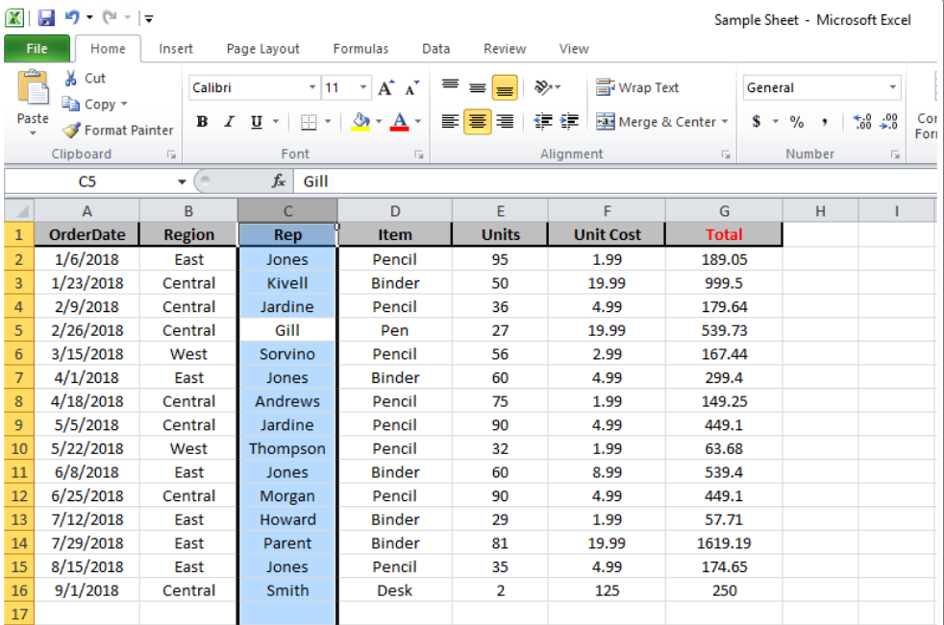
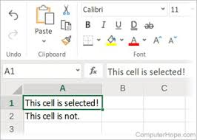
SELECTING CELLS
To select a single cell
To select range of cells

Slide 3
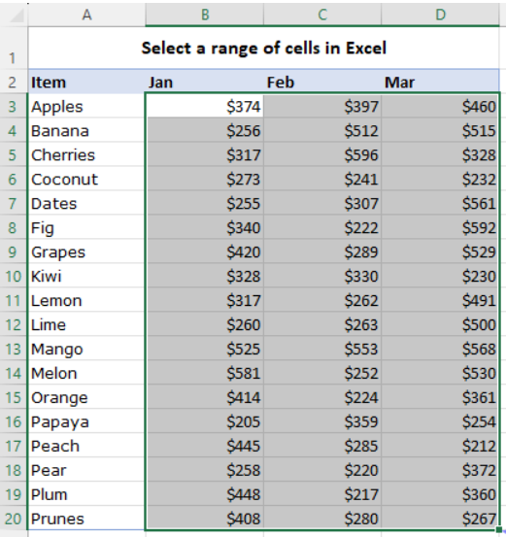
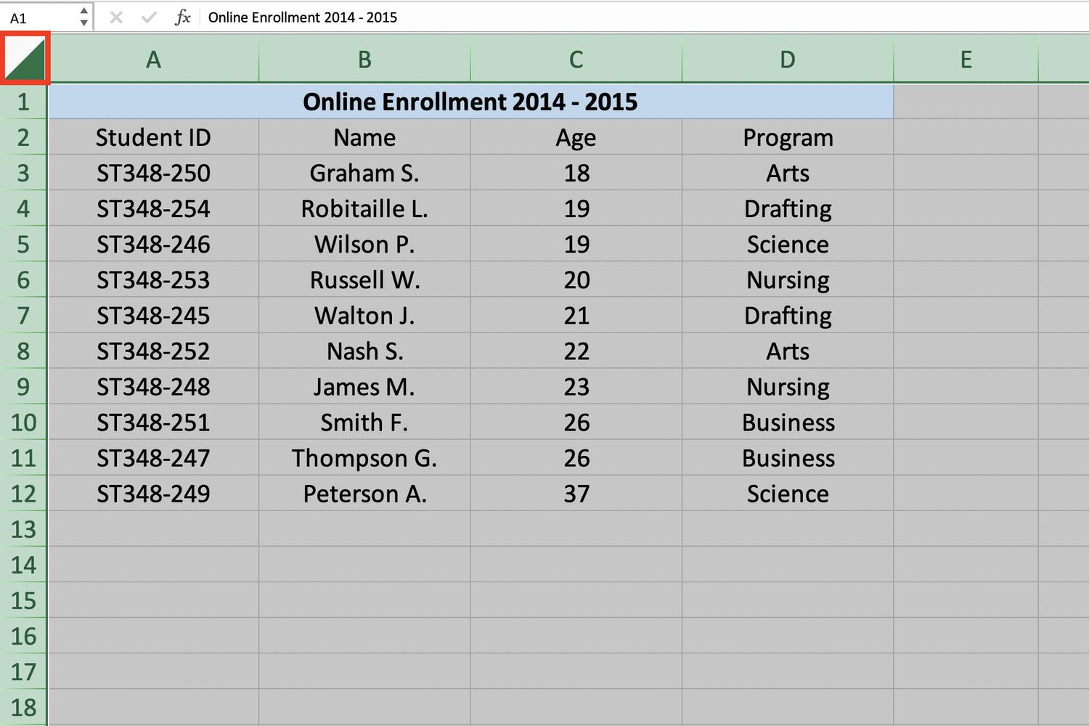
SELECTING CELLS
To select an entire worksheet
To select multiple ranges together

Slide 4
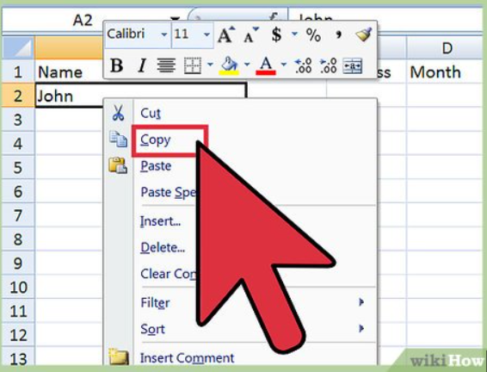
COPYING CELL CONTENTS

Slide 5
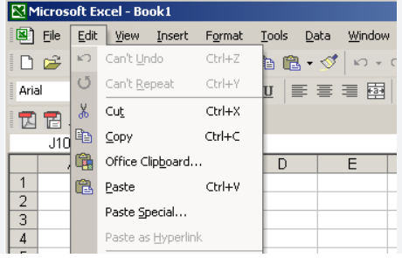
MOVING CELL CONTENTS

Slide 6
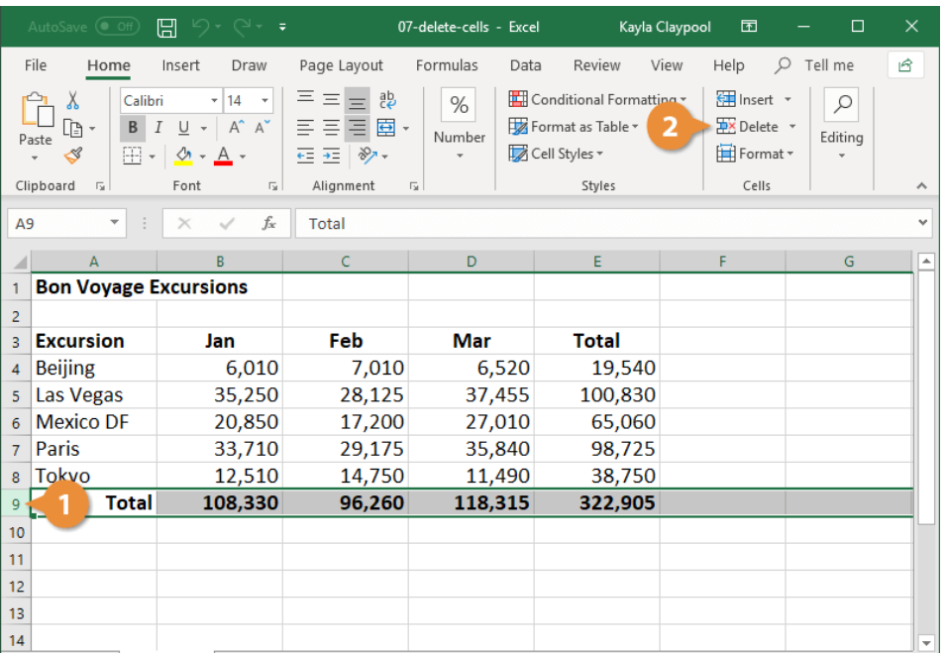
DELETING CELLS

Slide 7
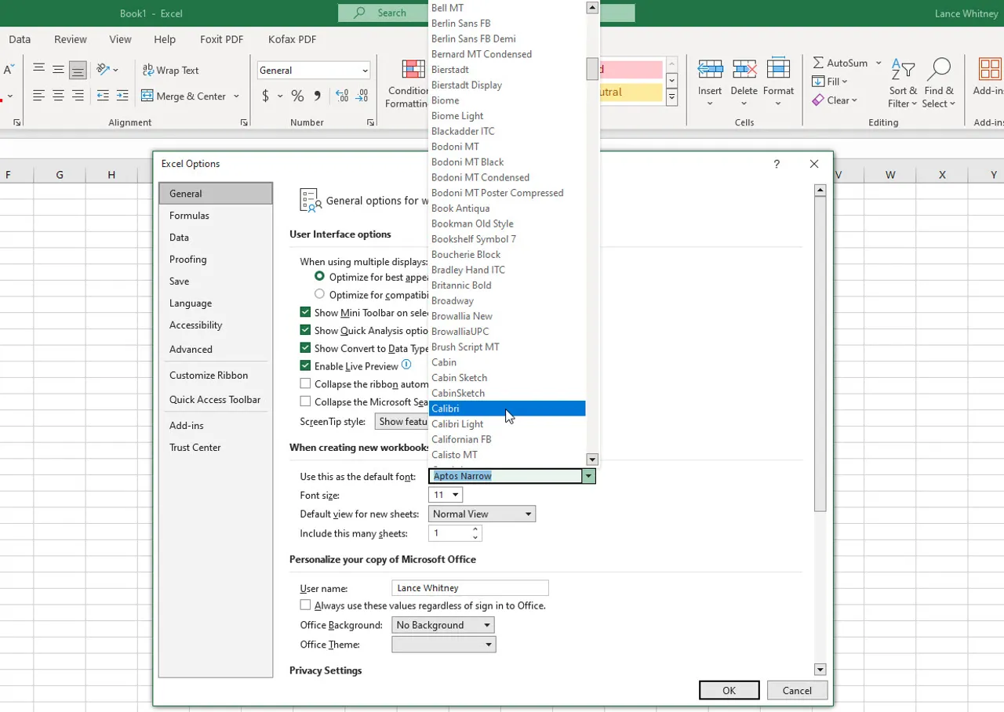
FONT GROUP
CHANGING FONT

Slide 8
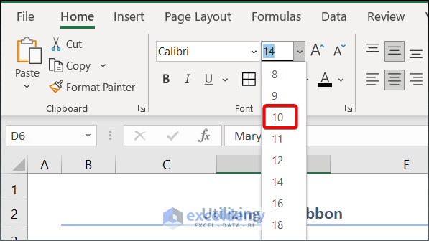
CHANGING FONT SIZE

Slide 9
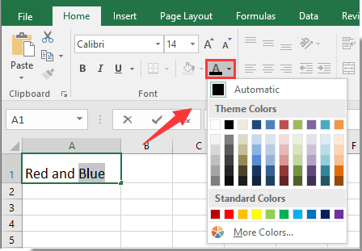
CHANGING FONT COLOUR

Slide 10
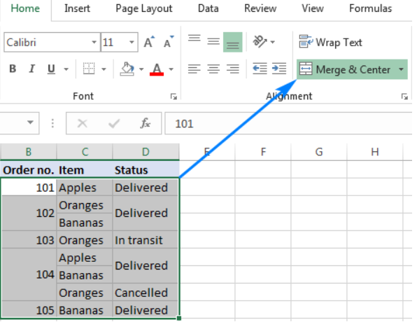
TO MERGE CELL

