Slide 1
ENGLISH
ORAL PRESENTATION
MEMBERS:
1.Sapna kumari
2.Ranveer
3.Yash raj
4.Aditya patel
5.Advik raj

Slide 2

THE NECKLACE

Slide 3

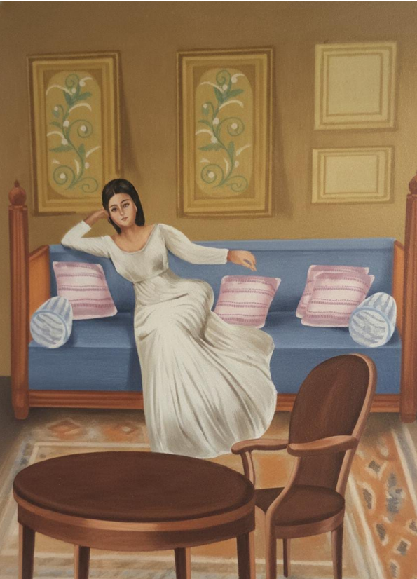
Madame loisel

Slide 4
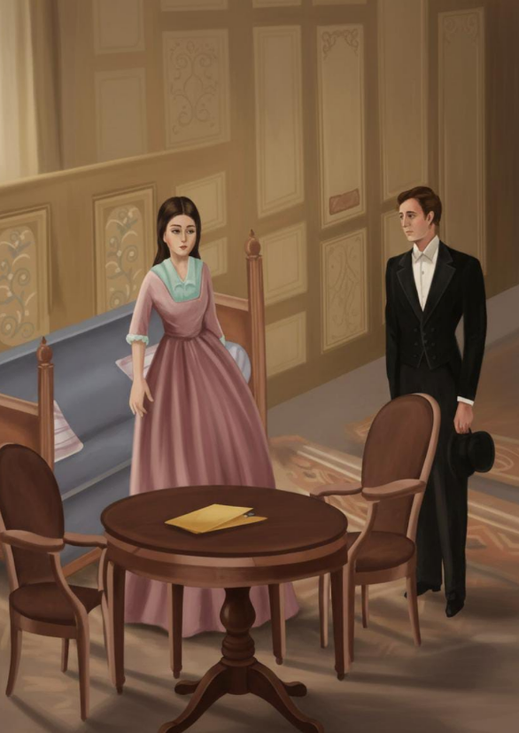

Slide 5
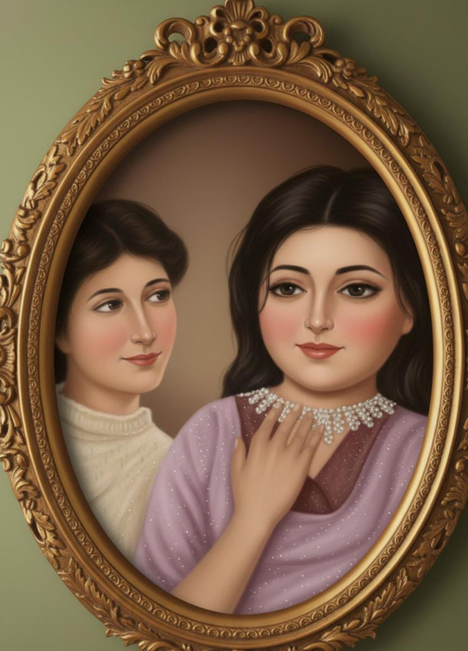

Slide 6
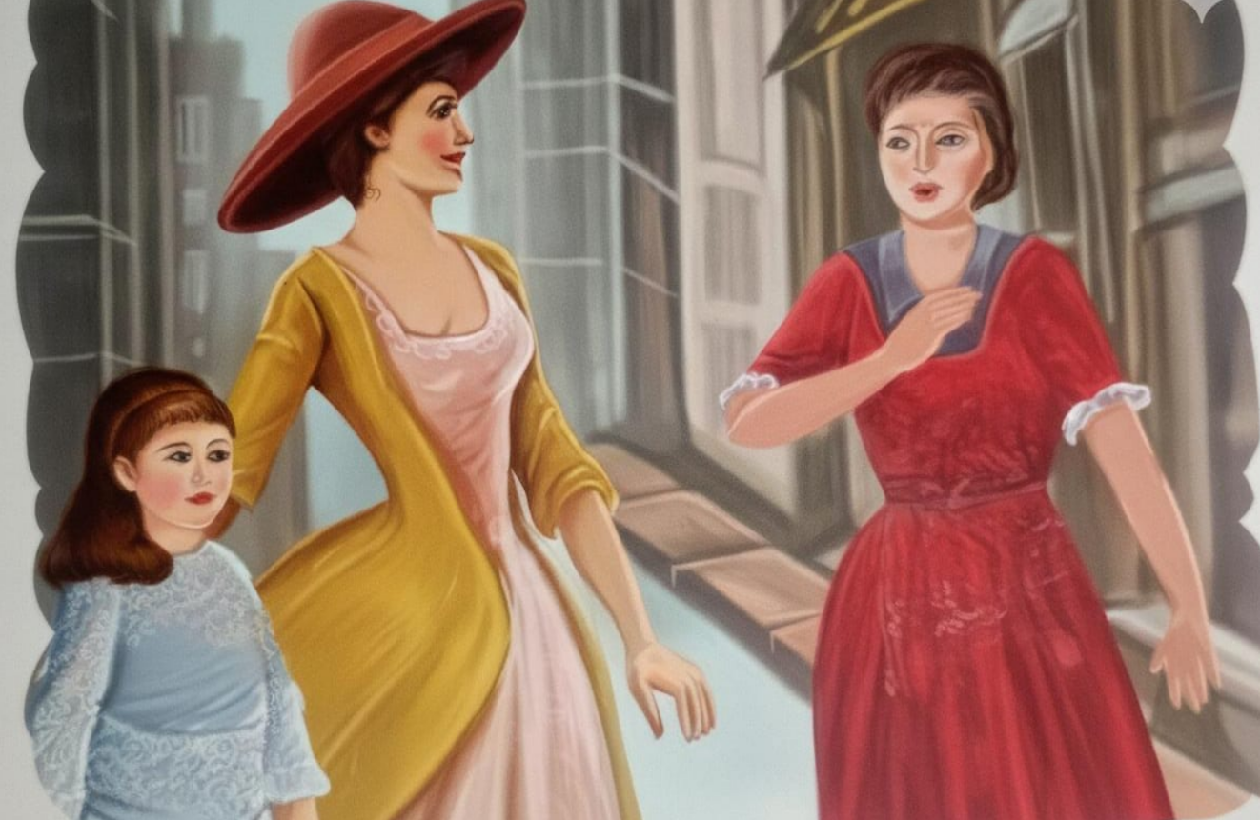

Slide 7
MORAL :-

Slide 8


