Slide 1


MATHS
PRESENTATION
TOPIC :- CIRCLES

Slide 2

CIRCLE

Slide 3
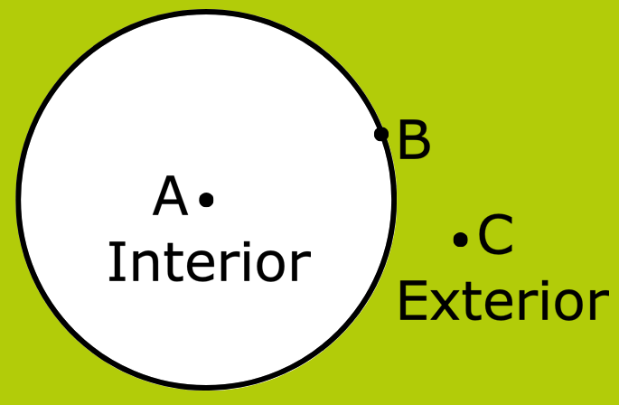
INTERIOR AND EXTERIOR OF CIRCLE

Slide 4
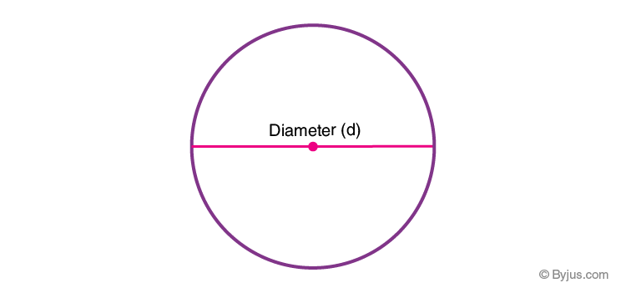
DIAMETER OF CIRCLE

Slide 5
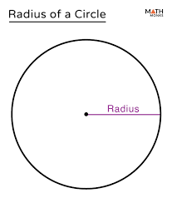
RADIUS OF A CIRCLE

Slide 6
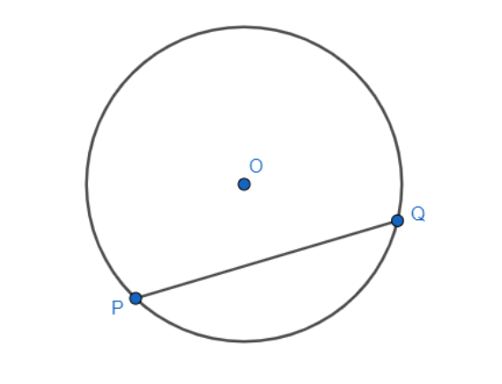
CHORD OF A CIRCLE

Slide 7
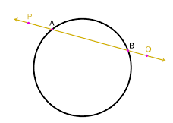
SECANT OF A CIRCLE

Slide 8
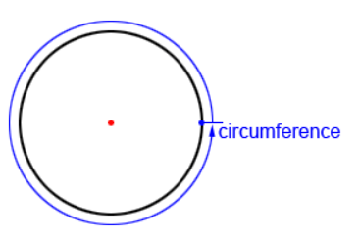
CIRCUMFERENCE OF A CIRCLE

Slide 9
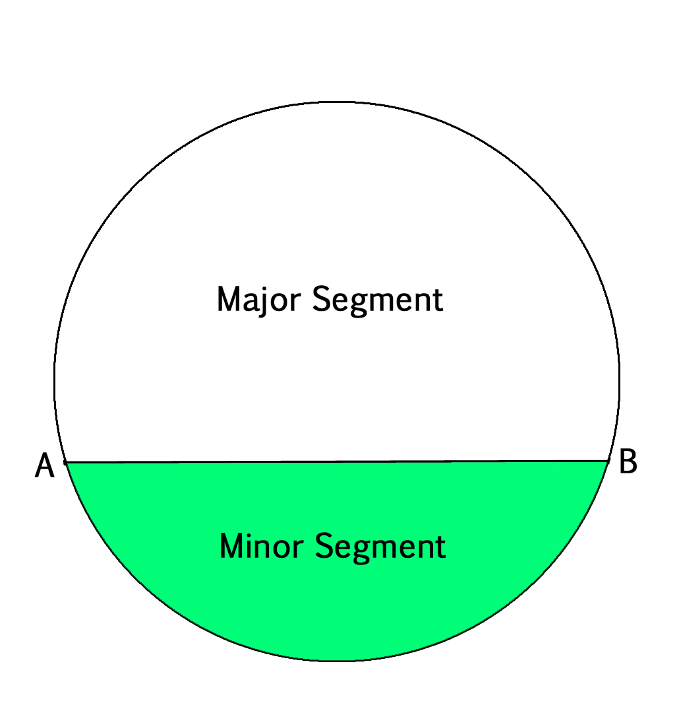
SEGMENTS OF A CIRCLE

Slide 10
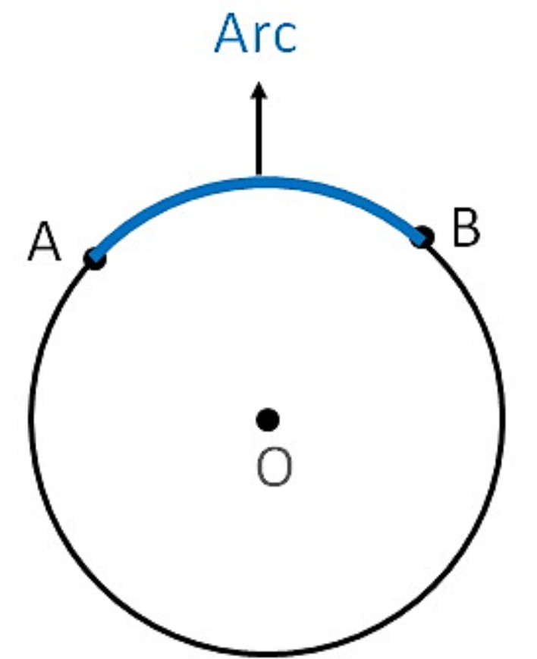
ARC OF A CIRCLE

Slide 11
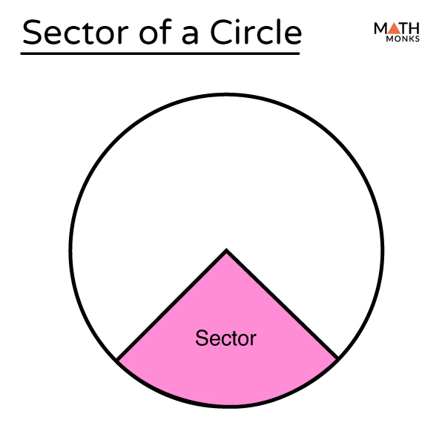
SECTOR OF A CIRCLE

Slide 12
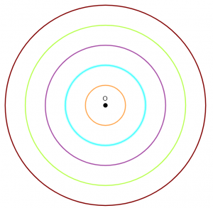
CONCENTRIC CIRCLES

Slide 13


