Slide 1
SCIENCE
PRESENTATION
NATURE ‘S TREASURE

Slide 2
NATURAL AND MAN-MADE RESOURCES
NATURAL RESOURCES :- All substances available in nature that are utilized by the living organisms to sustain life are called natural resources.
MAN-MADE RESOURCES:- All substances that are either made by humans or machines are called man-made resources.

Slide 3
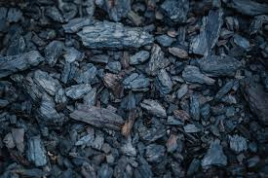
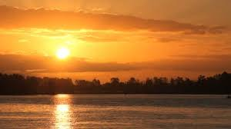
NATURAL RESOURCES
RENEWABLE RESOURCES
NON-RENEWABLE RESOURCES
Renewable resources are the resources which are regenerate after their consumption through natural cycles.
Non-renewable resources are the resources which are exhaustible. Once we used them up , they are gone forever.

Slide 4
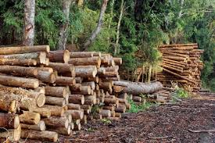
IMPACT OF EXCESSIVE USE OF NATURAL RESOURCES

Slide 5
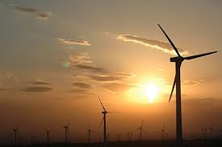
WIND ENERGY

Slide 6
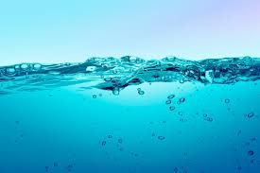
WATER

Slide 7
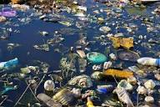
WATER POLLUTION

Slide 8
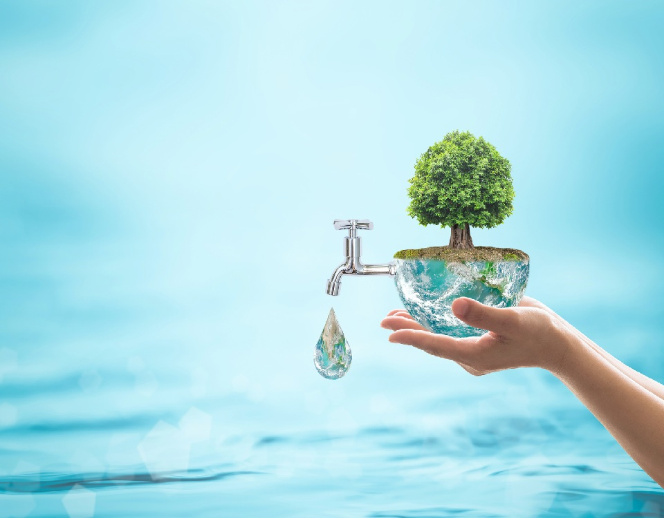
CONSERVATION OF WATER
RAINWATER HARVESTING
DRIP IRRIGATION
REUSE OF WATER
REFORESTATION
SAVE WATER,
SECURE FUTURE

Slide 9


